Slide 1

Evaluating and Optimizing your RAG App
Jerry Liu, LlamaIndex co-founder/CEO

Slide 2
RAG

Slide 3

Context
LLMs are a phenomenal piece of technology for knowledge generation and reasoning. They are pre-trained on large amounts of publicly available data.
Use Cases
Question-Answering
Text Generation
Summarization
Planning
LLM’s

Slide 4
















Context
How do we best augment LLMs with our own private data?
Raw Files
API’s
?
Use Cases
Question-Answering
Text Generation
Summarization
Planning
Vector Stores
SQL DB’s
LLM’s

Slide 5
Paradigms for inserting knowledge
Fine-tuning - baking knowledge into the weights of the network
Before college the two main things I worked on, outside of school, were writing and programming. I didn't write essays. I wrote what beginning writers were supposed to write then, and probably still are: short stories. My stories were awful. They had hardly any plot, just characters with strong feelings, which I imagined made them deep...
LLM
RLHF, Adam, SGD, etc.

Slide 6
Paradigms for inserting knowledge
Retrieval Augmentation - Fix the model, put context into the prompt
Before college the two main things I worked on, outside of school, were writing and programming. I didn't write essays. I wrote what beginning writers were supposed to write then, and probably still are: short stories. My stories were awful. They had hardly any plot, just characters with strong feelings, which I imagined made them deep...
Input Prompt
Here is the context:
Before college the two main things…
Given the context, answer the following question: {query_str}
LLM

Slide 7
LlamaIndex: A data framework for LLM applications
Data Management and Query Engine for your LLM application
Offers components across the data lifecycle: ingest, index, and query over data
Data Ingestion (LlamaHub 🦙)
Data Structures
Queries
Connect your existing data sources and data formats (API’s, PDF’s, docs, SQL, etc.)
Store and index your data for different use cases. Integrate with different db’s (vector db, graph db, kv db)
Retrieve and query over data
Includes: QA, Summarization, Agents, and more

Slide 8
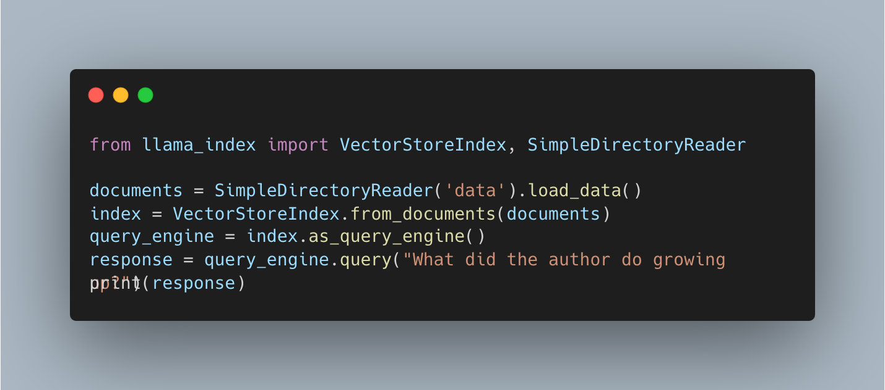

Slide 9
RAG Stack

Slide 10
Current RAG Stack for building a QA System
Data Ingestion / Parsing
Data Querying
Chunk
Vector Database
Chunk
Doc
Chunk
Chunk
LLM
Chunk
Chunk
Chunk
5 Lines of Code in LlamaIndex!

Slide 11
Current RAG Stack (Data Ingestion/Parsing)
Process:
Split up document(s) into even chunks.
Each chunk is a piece of raw text.
Generate embedding for each chunk (e.g. OpenAI embeddings, sentence_transformer)
Store each chunk into a vector database
Chunk
Vector Database
Chunk
Doc
Chunk
Chunk

Slide 12
Current RAG Stack (Querying)
Process:
Find top-k most similar chunks from vector database collection
Plug into LLM response synthesis module
Vector Database
Chunk
LLM
Chunk
Chunk

Slide 13
Current RAG Stack (Querying)
Process:
Find top-k most similar chunks from vector database collection
Plug into LLM response synthesis module
Vector Database
Chunk
LLM
Chunk
Chunk
Retrieval
Synthesis

Slide 14
Challenges with “Naive” RAG

Slide 15
Challenges with Naive RAG
Failure Modes
Quality-Related (Hallucination, Accuracy)
Non-Quality-Related (Latency, Cost, Syncing)

Slide 16
Challenges with Naive RAG (Response Quality)
Bad Retrieval
Low Precision: Not all chunks in retrieved set are relevant
Hallucination + Lost in the Middle Problems
Low Recall: Now all relevant chunks are retrieved.
Lacks enough context for LLM to synthesize an answer
Outdated information: The data is redundant or out of date.

Slide 17
Challenges with Naive RAG (Response Quality)
Bad Retrieval
Low Precision: Not all chunks in retrieved set are relevant
Hallucination + Lost in the Middle Problems
Low Recall: Now all relevant chunks are retrieved.
Lacks enough context for LLM to synthesize an answer
Outdated information: The data is redundant or out of date.
Bad Response Generation
Hallucination: Model makes up an answer that isn’t in the context.
Irrelevance: Model makes up an answer that doesn’t answer the question.
Toxicity/Bias: Model makes up an answer that’s harmful/offensive.

Slide 18
What do we do?
Data: Can we store additional information beyond raw text chunks?
Embeddings: Can we optimize our embedding representations?
Retrieval: Can we do better than top-k embedding lookup?
Synthesis: Can we use LLMs for more than generation?
But before all this…
We need a way to measure performance

Slide 19
Evaluation

Slide 20
Evaluation
How do we properly evaluate a RAG system?
Evaluate in isolation (retrieval, synthesis)
Evaluate e2e
Open question: which one should we do first?
Vector Database
Chunk
LLM
Chunk
Chunk
Retrieval
Synthesis

Slide 21
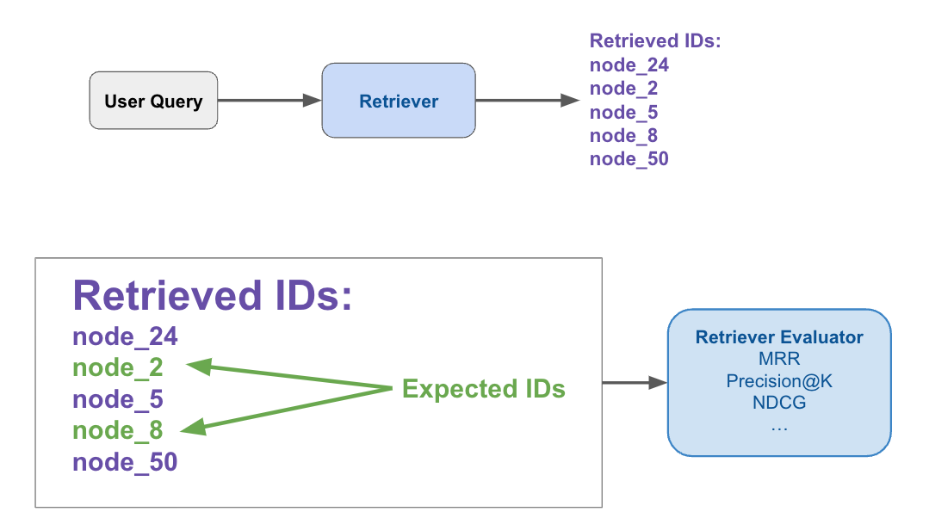
Evaluation in Isolation (Retrieval)
Details: Evaluate quality of retrieved chunks given user query
Collect dataset
Input: query
Output: the “ground-truth” documents relevant to the query
Run retriever over dataset
Measure ranking metrics
Success rate / hit-rate
MRR
Hit-rate

Slide 22
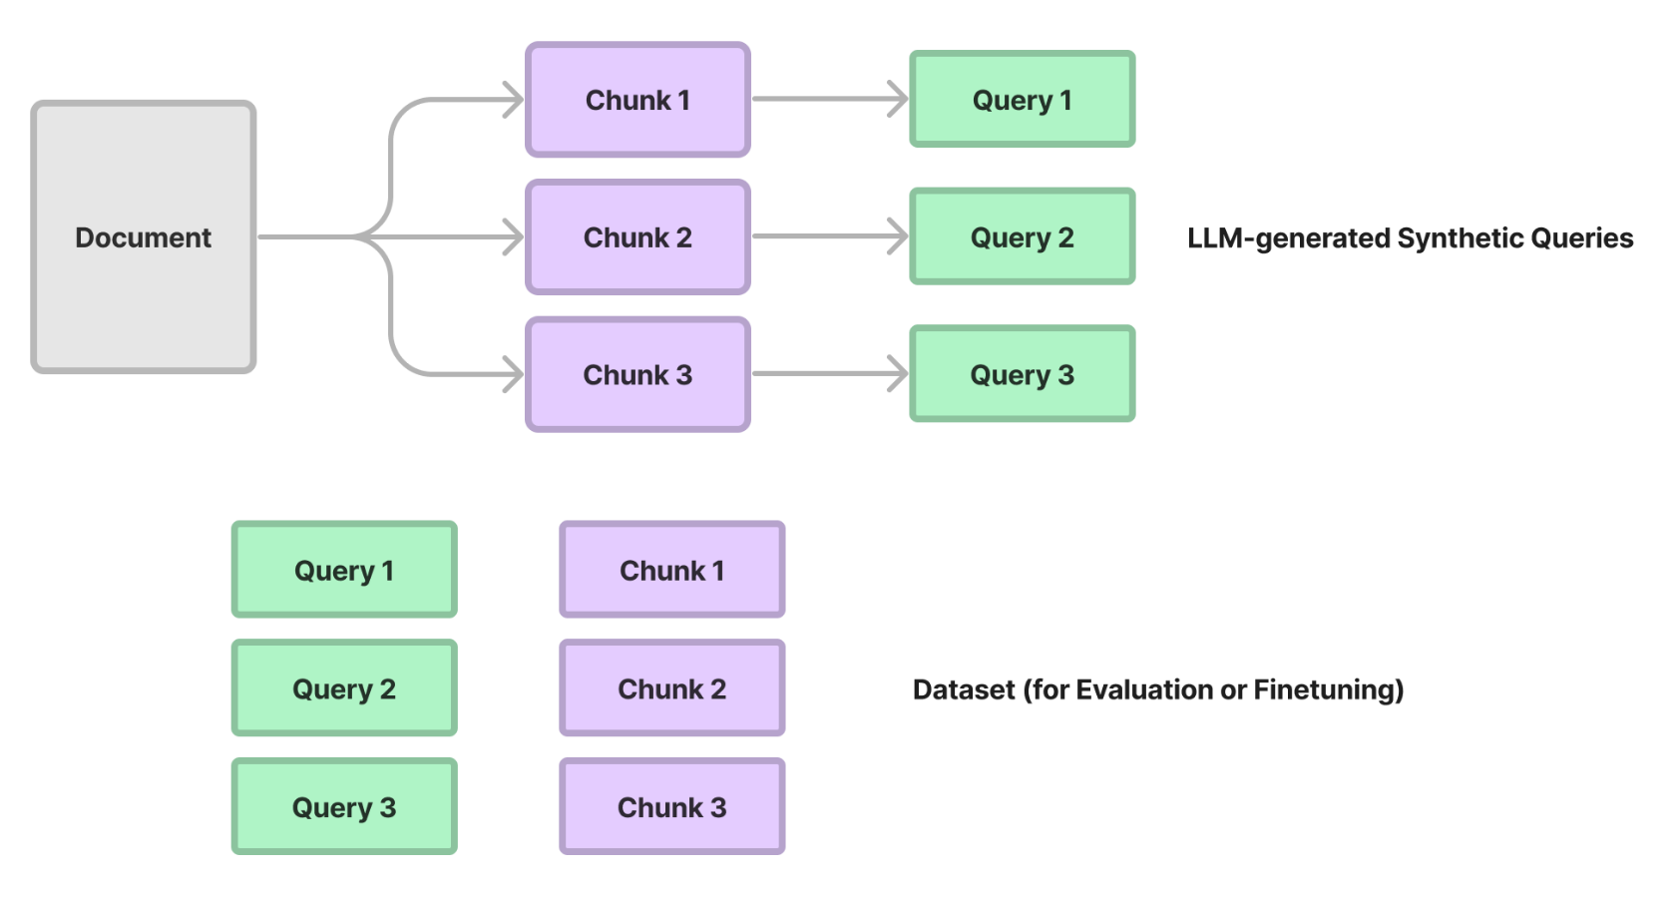
Synthetic Dataset Generation for Retrieval Evals
Parse / chunk up text corpus
Prompt GPT-4 to generate questions from each chunk (or subset of chunks)
Each (question, chunk) is now your evaluation pair!

Slide 23
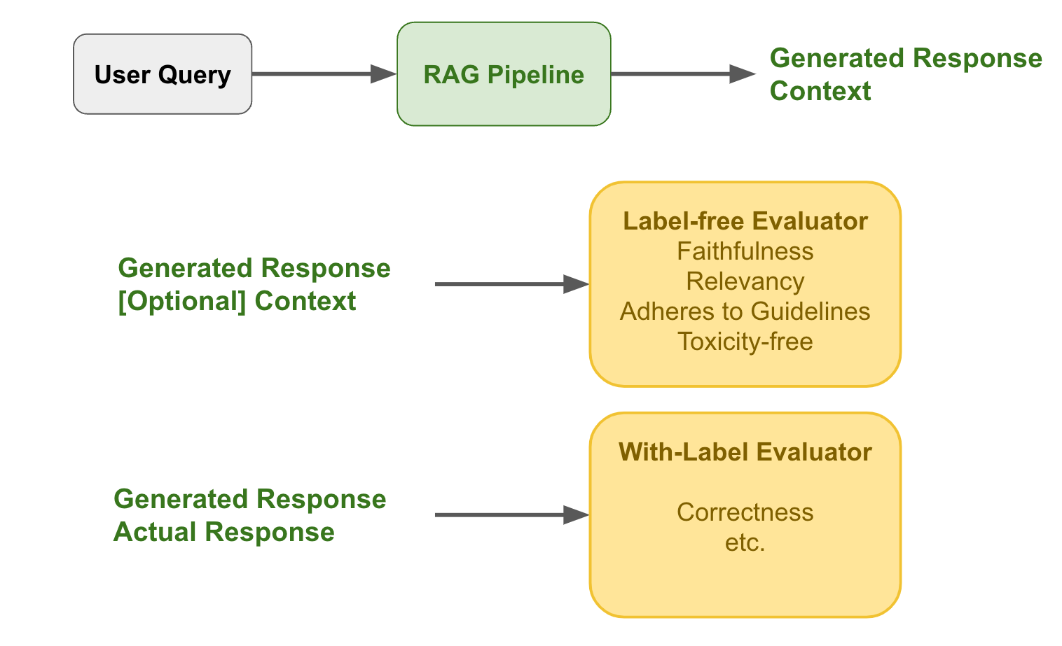
Evaluation E2E
Details: Evaluation of final generated response given input
Collect dataset
Input: query
[Optional] Output: the “ground-truth” answer
Run through full RAG pipeline
Collect evaluation metrics:
If no labels: label-free evals
If labels: with-label evals

Slide 24
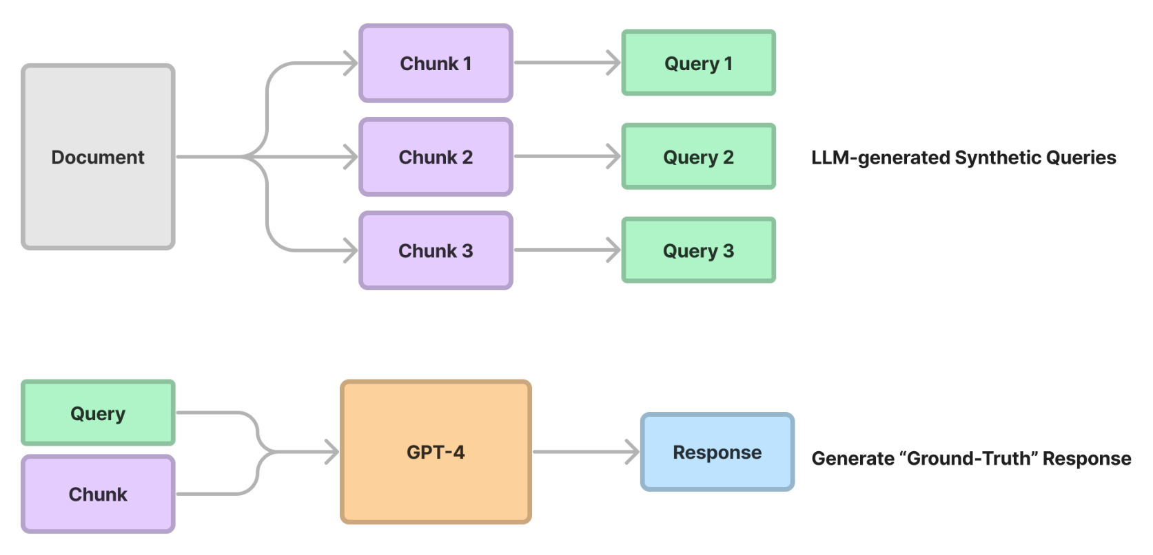
Synthetic Dataset Generation for E2E Evals
Parse / chunk up text corpus
Prompt GPT-4 to generate questions from each chunk
Run (question, context) through GPT-4 → Get a “ground-truth” response
Each (question, response) is now your evaluation pair!

Slide 25
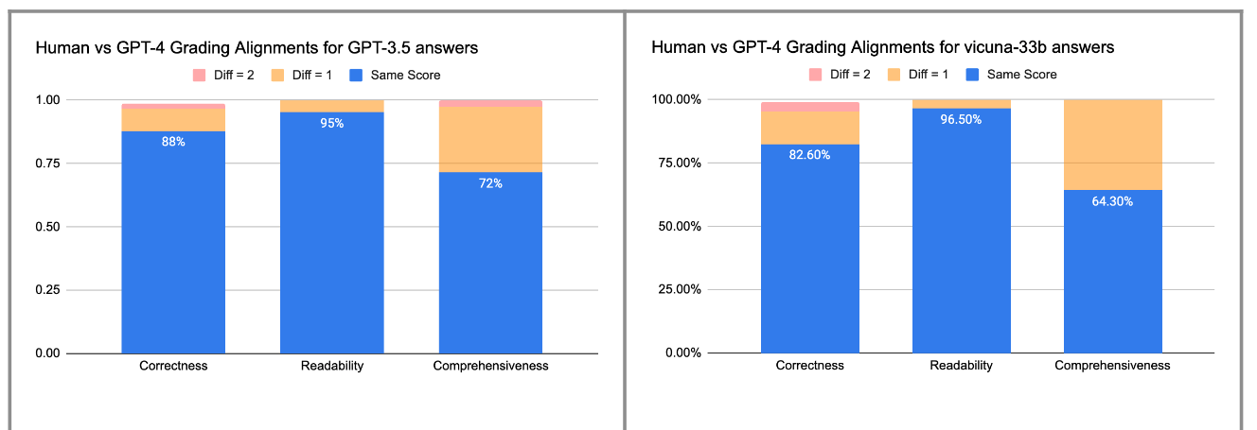
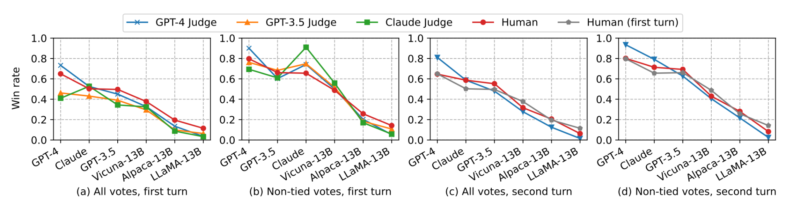
LLM-based Evaluation Modules
GPT-4 is a good human grader
Label-free Modules
Faithfulness: whether response matches retrieved context
Relevancy: whether response matches query
Guidelines: whether response matches guidelines
With-Labels
Correctness: whether response matches “golden” answer.
https://www.databricks.com/blog/LLM-auto-eval-best-practices-RAG
https://arxiv.org/pdf/2306.05685.pdf

Slide 26
Techniques for Better Performing RAG

Slide 27
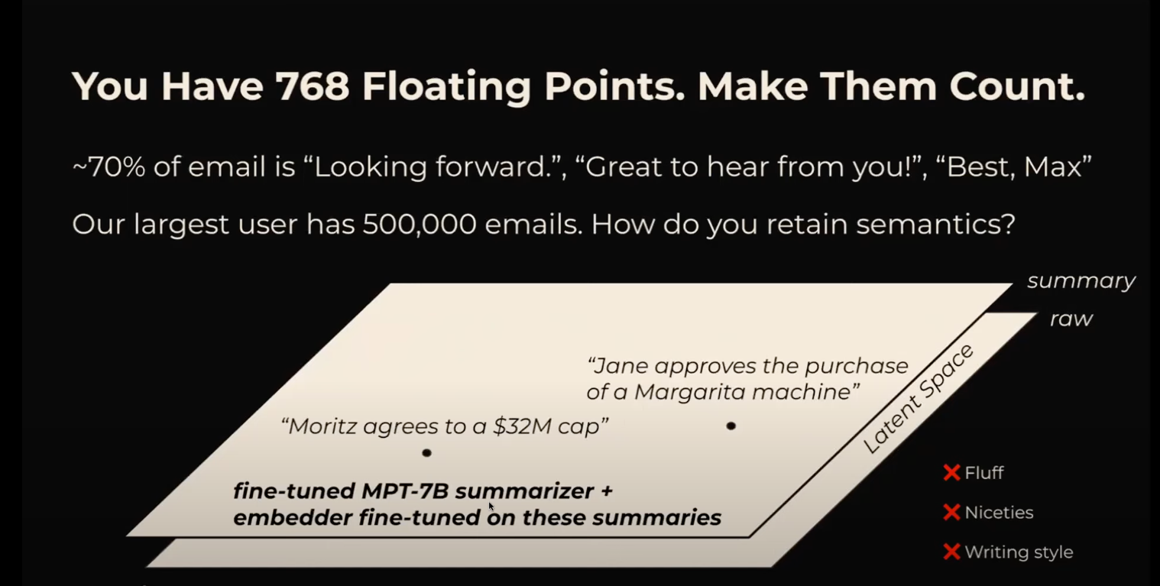
Decouple Embeddings from Raw Text Chunks
Raw text chunks can bias your embedding representation with filler content (Max Rumpf, sid.ai)

Slide 28
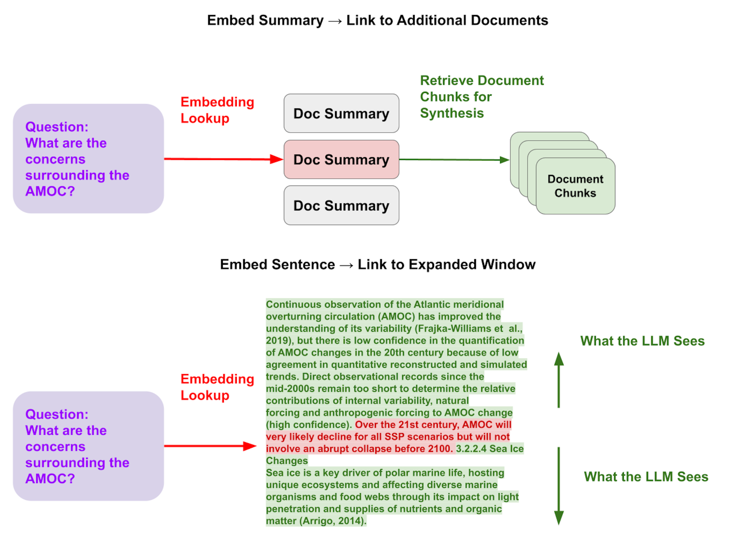
Small-to-Big Retrieval
Solutions:
Embed text at the sentence-level - then expand that window during LLM synthesis

Slide 29
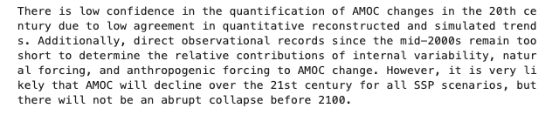
Small-to-Big Retrieval
Solutions:
Embed text at the sentence-level - then expand that window during LLM synthesis
Sentence Window Retrieval (k=2)
Naive Retrieval (k=5)
Only one out of the 5 chunks is relevant - “lost in the middle” problem

Slide 30
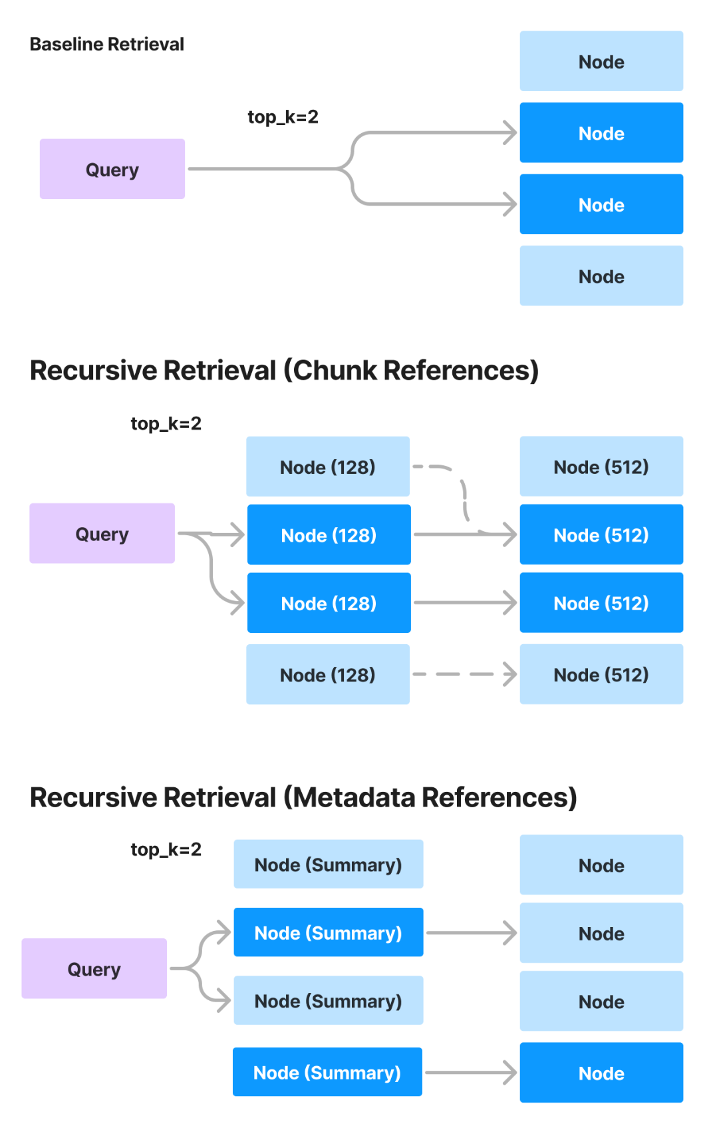
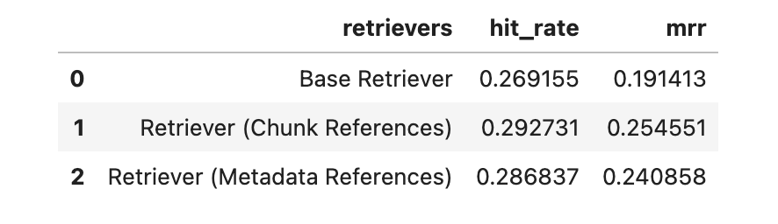
Embed References to Text Chunks
Solutions:
Embed “references” to text chunks instead of the text chunks directly.
Examples
Smaller Chunks
Metadata
Summaries
Retrieve those references first, then the text chunks.

Slide 31
Organize your data for more structured retrieval
(Recursive Retrieval)
Summaries → documents
Embed larger documents via summaries. First retrieve documents by summaries, then retrieve chunks within those documents

Slide 32
Organize your data for more structured retrieval
(Metadata)
Metadata: context you can inject into each text chunk
Examples
Page number
Document title
Summary of adjacent chunks
Questions that chunk can answer (reverse HyDE)
Benefits
Can Help Retrieval
Can Augment Response Quality
Integrates with Vector DB Metadata Filters
Example of Metadata
{“page_num”: 1, “org”: “OpenAI”}
Metadata
We report the development of GPT-4, a large-scale, multimodal…
Text Chunk

Slide 33
Organize your data for more structured retrieval
(Metadata Filters)
Question: “Can you tell me about Google’s R&D initiatives from 2020 to 2023?”
Dumping chunks to a single collection doesn’t work.
2020 10Q chunk 4
top-4
2020 10Q chunk 7
query_str: <query_embedding>
Single Collection of all 10Q Document Chunks
2021 10Q chunk 4
2023 10Q chunk 4
No guarantee you’ll return the relevant document chunks!

Slide 34
Organize your data for more structured retrieval
(Metadata Filters)
Question: “Can you tell me about Google’s R&D initiatives from 2020 to 2023?”
Here, we separate and tag the documents with metadata filters.
During query-time, we can infer these metadata filters in addition to semantic query.
query_str: <query_embedding>
Metadata tags:
<metadata_tags>
2020 10Q
2020 10Q chunk 4
2021 10Q
2021 10Q chunk 4
2022 10Q
2022 10Q chunk 4
2023 10Q
2023 10Q chunk 4

Slide 35
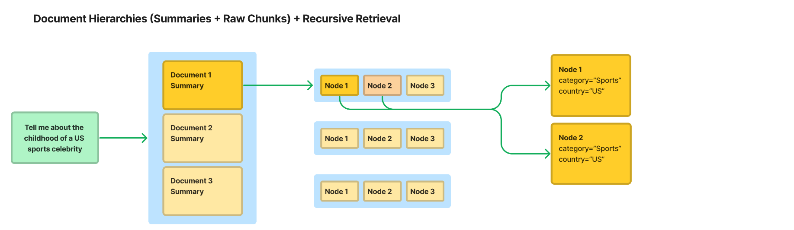
Organize your data for more structured retrieval
(Recursive Retrieval)
Organize your data hierarchically
Summaries → documents
Documents → embedded objects (Tables/Graphs)

Slide 36
Organize your data for more structured retrieval
(Recursive Retrieval)
Summaries → documents
Embed larger documents via summaries. First retrieve documents by summaries, then retrieve chunks within those documents

Slide 37
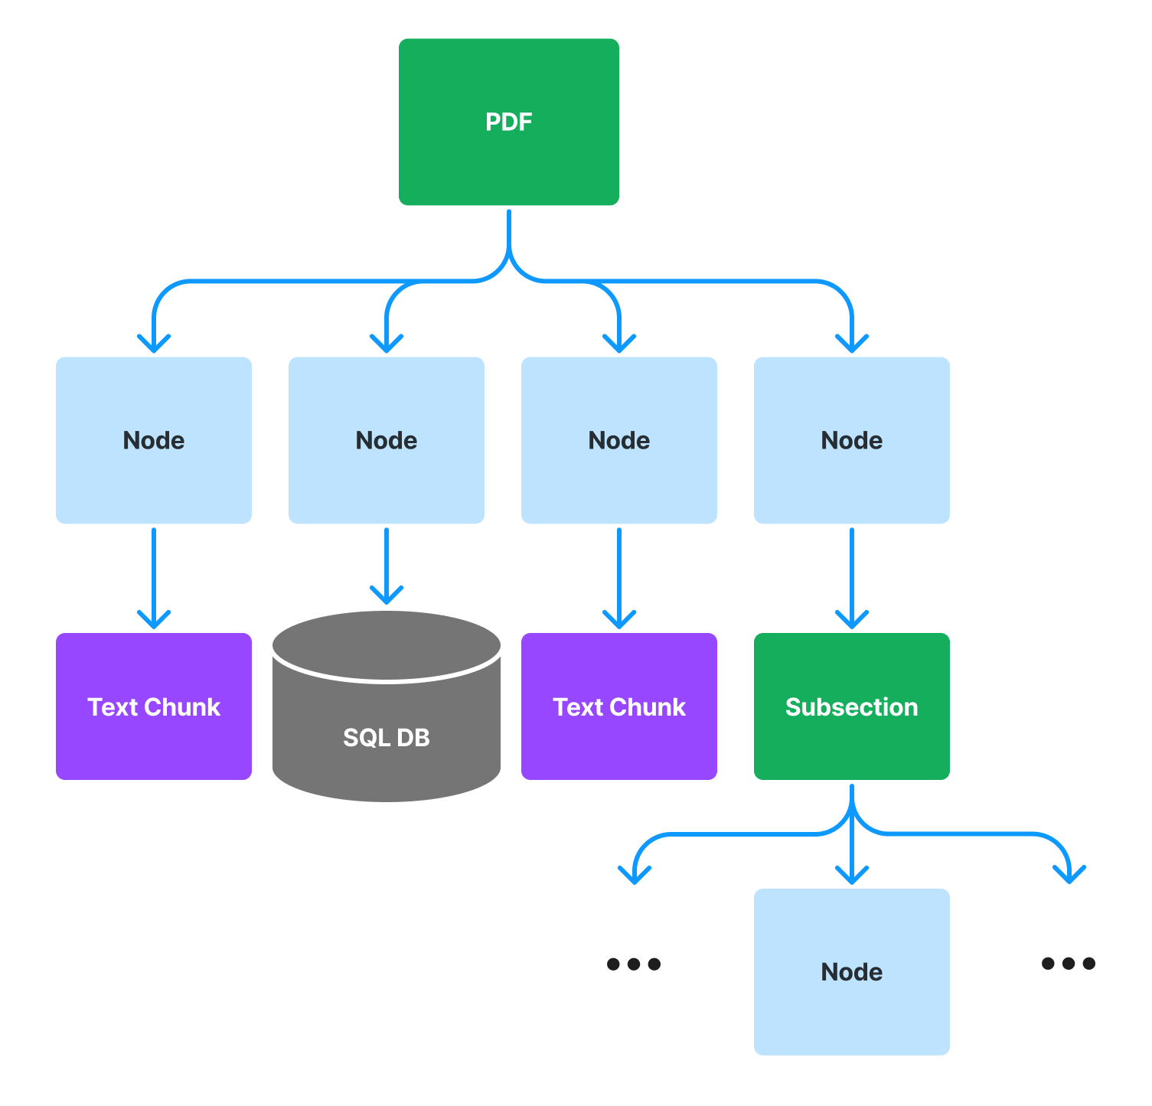
Organize your data for more structured retrieval
(Recursive Retrieval)
Documents → Embedded Objects
If you have embedded objects in your PDF documents (tables, graphs), first retrieve entities by a reference object, then query the underlying object.

Slide 38

Production RAG Guide
https://gpt-index.readthedocs.io/en/latest/end_to_end_tutorials/dev_practices/production_rag.html

Slide 39
Fine-Tuning

Slide 40
Fine-tuning
You can choose to fine-tune the embeddings or the LLM

Slide 41
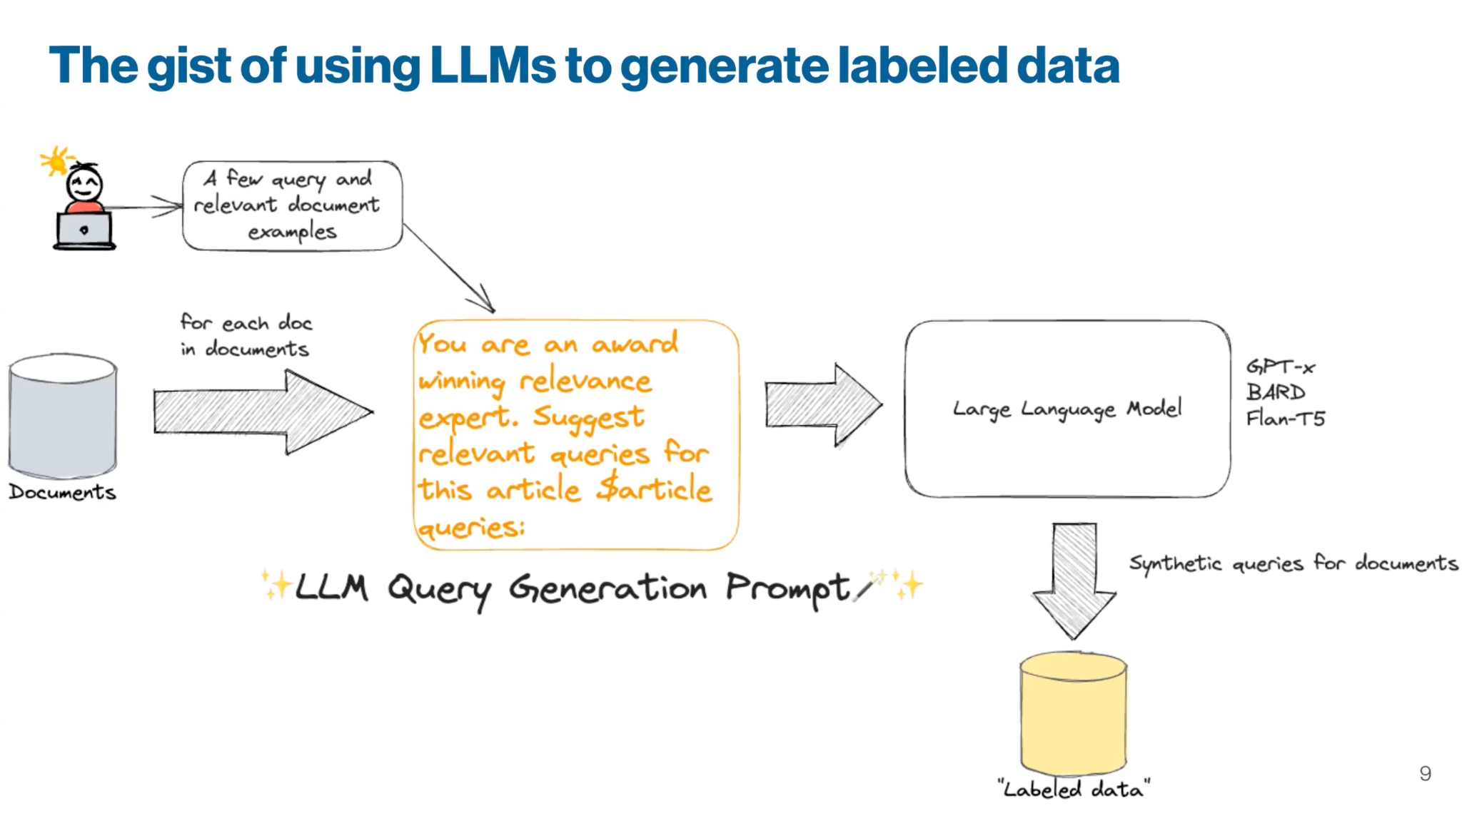
Fine-tuning (Embeddings)
Generate a synthetic query dataset from raw text chunks using LLMs
NOTE: Similar process to generating an evaluation dataset!
Credits: Jo Bergum, vespa.ai

Slide 42
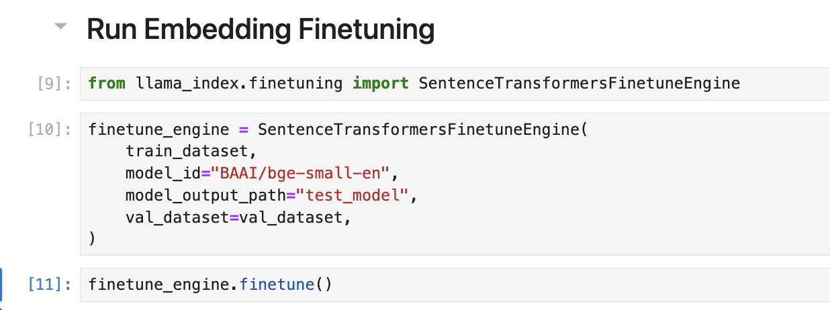
Fine-tuning (Embeddings)
Use this synthetic dataset to finetune an embedding model.
Directly finetune sentence_transformers model
Finetune a black-box adapter (linear, NN, any neural network)

Slide 43
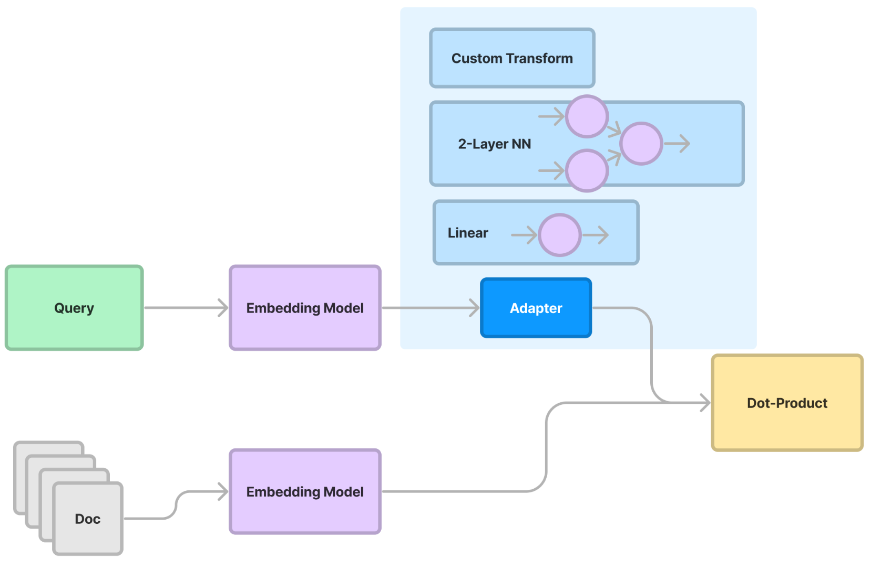
Fine-tuning a Black-box Adapter

Slide 44
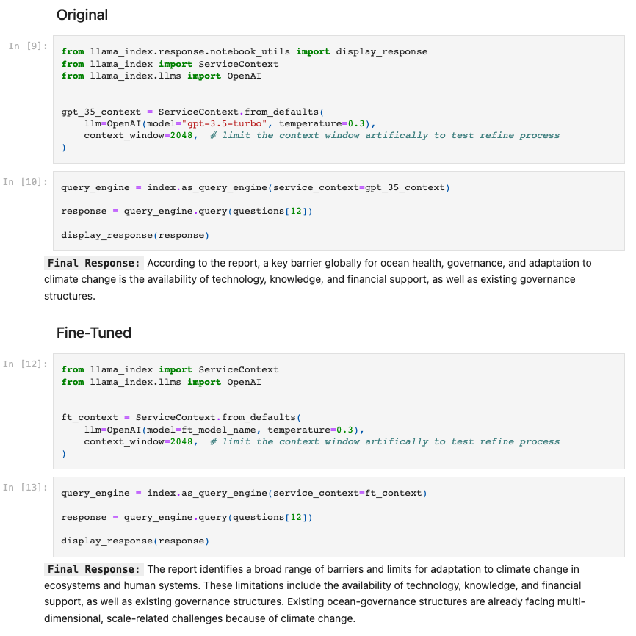
Fine-tuning (LLMs)
Use OpenAI to distill GPT-4 to gpt-3.5-turbo
Final response generation
Agent intermediate reasoning

Slide 45

Finetuning Abstractions in LlamaIndex
https://gpt-index.readthedocs.io/en/latest/end_to_end_tutorials/finetuning.html

